Slide 1
Data Story AirBnb Data

Slide 2
Overview
There are 75111 instances(rows) of the Train dataset and 25,458 rows of the Test Dataset
There are 29 column in the base dataset but we would process this to increase the column since the categorical columns would get added for each value.

Slide 3
We perform basic analysis of the Airbnb data to get insight of the data and various trends and anomalies and missing values if any
We would plot some graphs like the histogram/bar scatter plots to check various trends.
Also we would check the correlation of the price to various variables to see which one may affect price more.

Slide 4
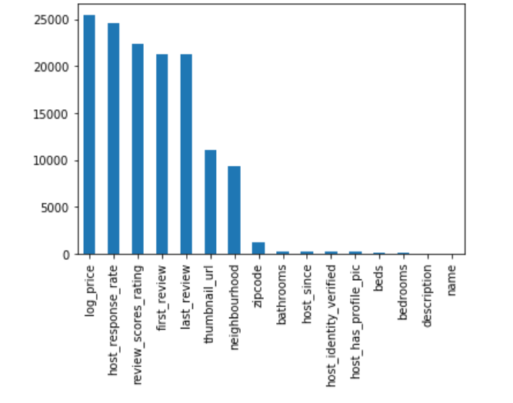
Missing Data
We Calculate the missing data for various column and plot the bar graph which helps us find columns with more missing data
As seen the host_response_rate and review_score_ratings seem to have the major chunck of missing values
We remove the NAN values from our dataset

Slide 5
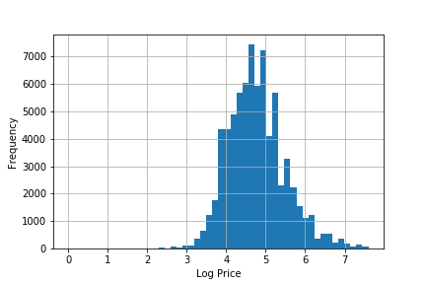
Histogram of Log Price
First we perform a Histogram of the Log Price to check the maximum frequency of the log price
So the major price frequency occurs around value of 4.5 which consist of most of the Log price points.

Slide 6
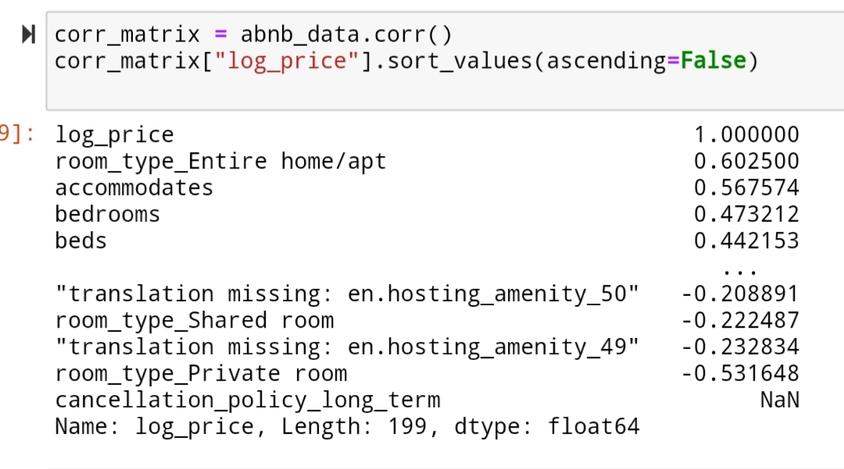
Correlations
We find out the correlations of various fields with respect to the log price To get and idea of their influence on the the log price
From the correlation matrix it seems that the type of room,number of people it accommodates and number of bedrooms in property have higher influence on the price.

Slide 7
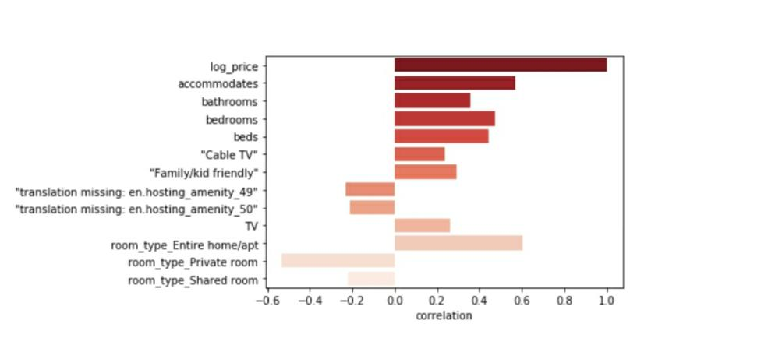
Correlations
We plot the same correlation matrix values for log price to get a graphical sense as a bar plot
As seen Higher correlations are visualized on either side

Slide 8
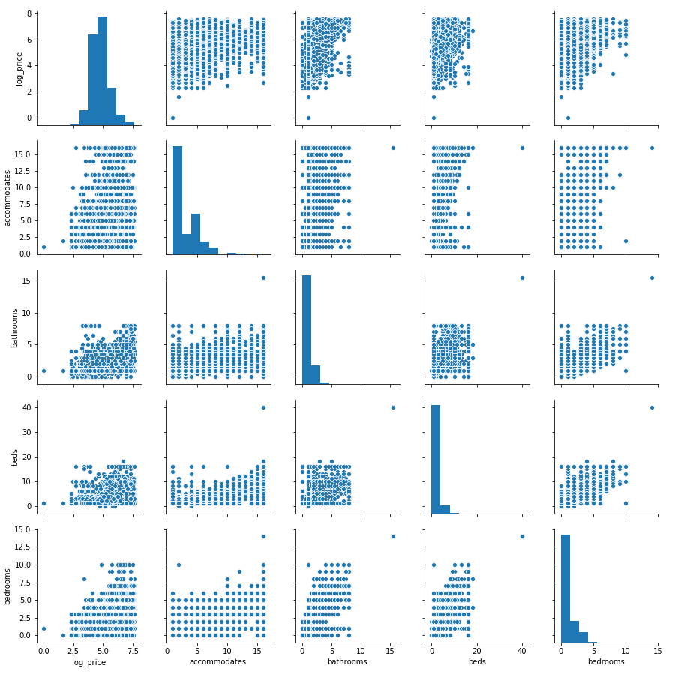
Pair Plots for correlated variables
As you see below the pair plot for high correlated items
Price increases with an increase in accommodates, bedrooms, bathrooms, beds and number of guests allowed.

Slide 9
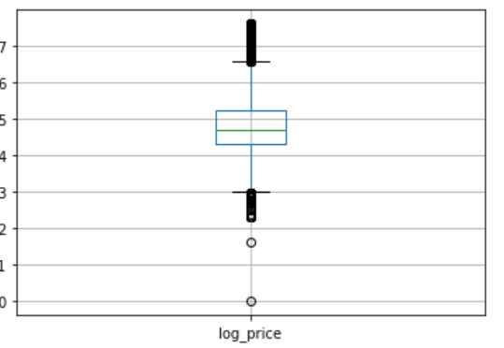
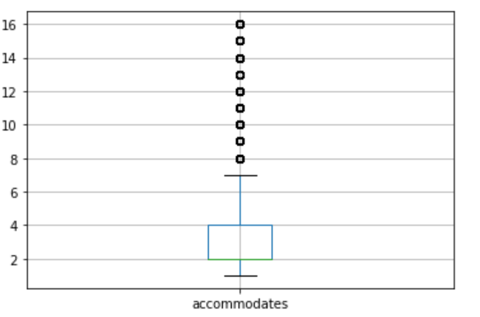
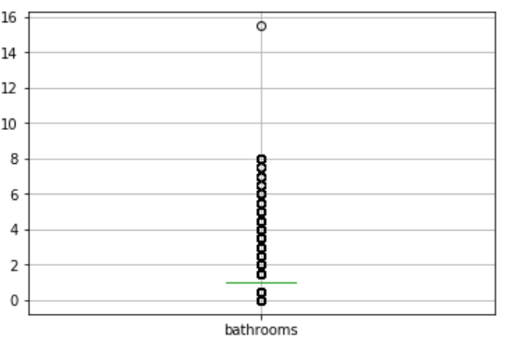
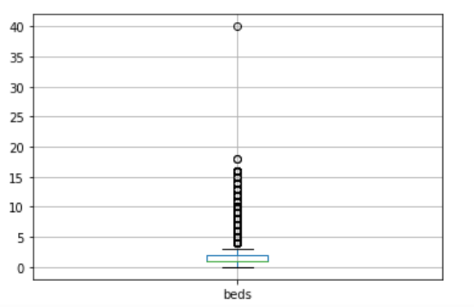
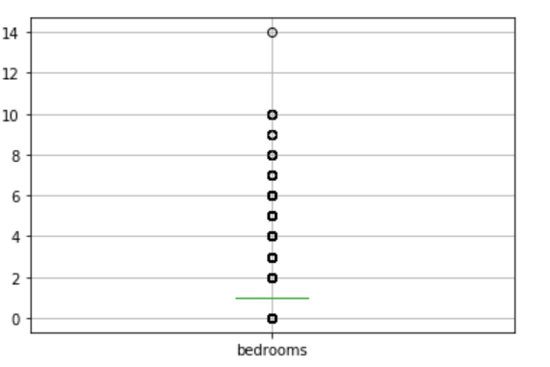
Outlier
We plot box plots to have a visual cue regarding the outliers

